Slide 1
Deployment Patterns
Pravin Y Pawar
Adapted from “Machine Lerning Engineering”
By Andriy Burkov

Slide 2
Model Deployment Patterns
Once the model has been built and thoroughly tested, it can be deployed
means to make it available for accepting queries generated by the users of the production system
Once the production system accepts the query, the latter is transformed into a feature vector
The feature vector is then sent to the model as input for scoring
The result of the scoring then is returned to the user
A trained model can be deployed in various ways
can be deployed on a server, or on a user’s device
can be deployed for all users at once, or to a small fraction of users
A model can be deployed following several patterns:
statically, as a part of an installable software package,
dynamically on the user’s device,
dynamically on a server, or
via model streaming

Slide 3
Static Deployment
Very similar to traditional software deployment
prepare an installable binary of the entire software
model is packaged as a resource available at the runtime
Depending on the operating system and the runtime environment
Objects of both the model and the feature extractor can be packaged as a
part of a dynamic-link library (DLL on Windows),
Shared Objects (*.so files on Linux),
or be serialized and saved in the standard resource location for virtual machine-based systems,
such as Java and .Net.

Slide 4
Static Deployment(2)
Pros and Cons
Many advantages:
software has direct access to the model, so the execution time is fast for the user
user data doesn’t have to be uploaded to the server at the time of prediction
saves time and preserves privacy
model can be called when the user is offline
software vendor doesn’t have to care about keeping the model operational
becomes the user’s responsibility
Several drawbacks:
The separation of concerns between the machine learning code and the application code isn’t always obvious
makes it harder to upgrade the model without also having to upgrade the entire application
If the model has certain computational requirements for scoring (such as access to an accelerator or a GPU)
may add complexity and confusion as to where the static deployment can or cannot be used

Slide 5
Dynamic Deployment on User’s Device
Similar to a static deployment, in the sense the user runs a part of the system as a software application on their device
Difference is that in dynamic deployment, the model is not part of the binary code of the application
Achieves better separation of concerns!
Pushing model updates is done without updating the whole application running on the user’s device
Dynamic deployment can be achieved in several ways:
by deploying model parameters,
by deploying a serialized object, and
by deploying to the browser

Slide 6
Deployment of Model Parameters
In this deployment scenario, the model file only contains the learned parameters
user’s device has installed a runtime environment for the model
Some machine learning packages, like TensorFlow,
have a lightweight version that can run on mobile devices
Alternatively, frameworks such as Apple’s Core ML allow running models on Apple devices
created using popular packages, including scikit-learn, Keras, and XGBoost

Slide 7
Deployment of a Serialized Object
Model file is a serialized object that the application would deserialize
The advantage is that don’t need to have a runtime environment for model on the user’s device
all needed dependencies will be deserialized with the object of the model
An evident drawback is that an update might be quite “heavy,”
which is a problem if your software system has millions of users

Slide 8
Deploying to Browser
Most modern devices have access to a browser, either desktop or mobile
Some machine learning frameworks, such as TensorFlow.js,
have versions that allow to train and run a model in a browser, by using JavaScript as a runtime
Even possible to train a TensorFlow model in Python,
then deploy it to, and run it in the browser’s JavaScript runtime environment
if a GPU (graphics processing unit) is available on the client’s device, Tensorflow.js can leverage it

Slide 9
Dynamic Deployment on User’s Device(2)
Advantages and Drawbacks
Advantages
Calls to the model will be fast for the user
Reduces the impact on the organization’s servers, as most computations are performed on the user’s device
If the model is deployed to the browser,
advantage is organization’s infrastructure only needs to serve a web page that includes the model’s parameters
A downside is bandwidth cost and application startup time might increase.
users must download the model’s parameters each time they start the web application
as opposed to doing it only once when they install an application

Slide 10
Dynamic Deployment on User’s Device(3)
Advantages and Drawbacks
Monitoring
Deploying to a user’s device makes it difficult to monitor the model performance
Model updates
A serialized object can be quite voluminous
Some users may be offline during the update, or even turn off all future updates
may end up with different users using very different model versions
becomes difficult to upgrade the server-side part of the application
Third-party analyses
Deploying models on the user’s device means that the model easily becomes available for third-party analyses
may try to reverse-engineer the model to reproduce its behavior
may search for weaknesses by providing various inputs and observing the output
may adapt their data so the model predicts what they want

Slide 11
Dynamic Deployment on a Server
Because of the complications with other approaches, and problems with performance monitoring,
Most frequent deployment pattern is to place the model on a server (or servers),
make it available as
a Representational State Transfer application programming interface (REST API) in the form of a web service,
Google’s Remote Procedure Call (gRPC) service
Four common practices
Deployment on a Virtual Machine
Deployment in a Container
Serverless Deployment
Model Streaming

Slide 12
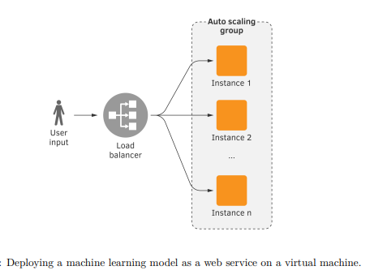
Deployment on a Virtual Machine(VM)
In a typical web service architecture deployed in a cloud environment
predictions are served in response to canonically-formatted HTTP requests
A web service running on a virtual machine
receives a user request containing the input data,
calls the machine learning system on that input data
then transforms the output of the machine learning system into the output JSON or XML string
To cope with high load, several identical VMs are running in parallel
A load balancer dispatches the incoming requests to a specific virtual machine
VMs can be added and closed manually, or be a part of an autoscaling group that launches
VMs can be terminated virtual machines based on their usage

Slide 13
Deployment on a Virtual Machine(VM)2
In Python, a REST API web service is usually implemented
using a web application framework such as Flask or FastAPI
TensorFlow, a popular framework used to train deep models,
comes with TensorFlow Serving, a built-in gRPC service
Advantage: Architecture of the software system is conceptually simple: a typical web or gRPC service
Downsides
Need to maintain servers (physical or virtual)
If virtualization is used, there is an additional computational overhead due to virtualization and running multiple OS
Network latency, which can be a serious issue, depending on how fast you need to process scoring results
has a relatively higher cost, compared to deployment in a container, or a serverless deployment

Slide 14
Deployment in a Container
A more modern alternative to a virtual-machine-based deployment
considered more resource-efficient and flexible than with virtual machines
A container is similar to a virtual machine
in the sense that it is also an isolated runtime environment with its own filesystem, CPU, memory, and process space
The main difference, however, is that all containers are running on the same virtual or physical machine
share the operating system, while each virtual machine runs its own instance of the operating system
Deployment Process
The machine learning system and the web service are installed inside a container
Usually, a container is a Docker container, but there are alternatives
Then a container-orchestration system is used to run the containers on a cluster of physical or virtual servers
A typical choice of a container-orchestration system for running on-premises or in a cloud platform, is Kubernetes
Some cloud platforms provide both their own container-orchestration engine, such as AWS Fargate and Google Kubernetes Engine

Slide 15
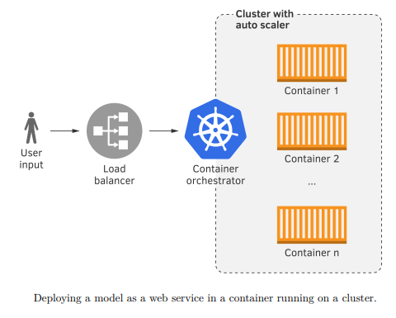
Deployment in a Container(2)
Organization
Virtual or physical machines are organized into a cluster,
whose resources are managed by the container orchestrator
New virtual or physical machines can be manually added to the cluster, or closed
If your software is deployed in a cloud environment,
a cluster autoscaler can launch (and add to the cluster) or terminate virtual machines
based on the usage of the cluster.

Slide 16
Deployment in a Container(3)
Advantage
More resource-efficient as compared to the deployment on a virtual machine
Allows the possibility to automatically scale with scoring requests
Allows us to scale-to-zero- reduced down to zero replicas when idle and brought back up if there is a request to serve
the resource consumption is low compared to always running services
leads to less power consumption and saves cost of cloud resources
Drawback
Containerized deployment is generally seen as more complicated, and requires expertise

Slide 17
Serverless Deployment
Several cloud services providers, including Amazon, Google, and Microsoft, offers serverless computing
Lambda-functions on Amazon Web Services, and Functions on Microsoft Azure and Google Cloud Platform
The serverless deployment consists of preparing a zip archive
with all the code needed to run the machine learning system (model, feature extractor, and scoring code)
must contain a file with a specific name that contains a specific function
is uploaded to the cloud platform and registered under a unique name
The cloud platform provides an API to submit inputs to the serverless function
specifies its name, provides the payload, and yields the outputs
The cloud platform takes care of
deploying the code and the model on an adequate computational resource,
executing the code,
routing the output back to the client

Slide 18
Serverless Deployment(2)
Advantages and Limitations
Advantages to relying on serverless deployment
don’t have to provision resources such as servers or virtual machines
don’t have to install dependencies, maintain, or upgrade the system
highly scalable and can easily and effortlessly support thousands of requests per second
support both synchronous and asynchronous modes of operation
cost-efficient: only pay for compute-time
simplifies canary deployment, or canarying
Rollbacks are also very simple in the serverless deployment because it is easy to switch back to the previous version of the function
Limitations
Restrictions by the cloud service provider
the function’s execution time, zip file size, and amount of RAM available on the runtime
Zip file size limit can be a challenge - A typical model requires multiple heavyweight dependencies
Unavailability of GPU access can be a significant limitation for deploying deep models

Slide 19
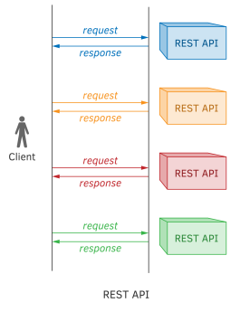
Model Serving – REST API Revisited
In complex systems, there can be many models applied to the same input
a model can input a prediction from another model
For example, the input may be a news article
One model can predict the topic of the article
Another model can extract named entities
Third model can generate a summarization of the article, and so on
According to the REST API deployment pattern, need one REST API per model
client would call one API by sending a news article as a part of the request - get the topic as response
client calls another API by sending a news article, and gets the named entities as response; etc.

Slide 20
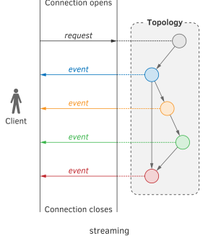
Model Streaming
Can be seen as an inverse to the REST API
Streaming works differently
All models, as well as the code needed to run them, are registered within a stream-processing engine (SPE)
Apache Storm, Apache Spark, and Apache Flink
Or, they are packaged as an application based on a stream-processing library (SPL),
such as Apache Samza, Apache Kafka Streams, and Akka Streams
Based on notion of data processing topology
Input data flows in as an infinite stream of data elements sent by the client
Following a predefined topology, each data element in the stream undergoes a transformation in the nodes of the topology
Transformed, the flow continues to other nodes.
In a stream-processing application, nodes transform their input in some way,
then either,
send the output to other nodes, or
send the output to the client, or
persist the output to the database or a filesystem.

Slide 21
Thank You!
In our next session:

